Slide 1
Analysis of Algorithms
Lecture 1

Slide 2
Course Outline
as per HEC

Slide 3
Course Material
Introduction to Algorithms, Thomas H. Cormen, Charles E. Leiserson, Ronald L. Rivest and Clifford Stein, MIT press, Third Edition, 2009
Data Structures and Algorithm Analysis in C++ by Mark Allen Weiss, Fourth Edition, 2013
Algorithms by Robert Sedgewick and Kevin Wayne, 4th Edition 2011

Slide 4
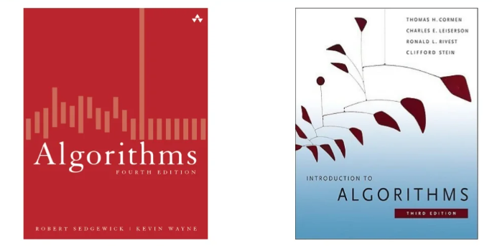
Books

Slide 5
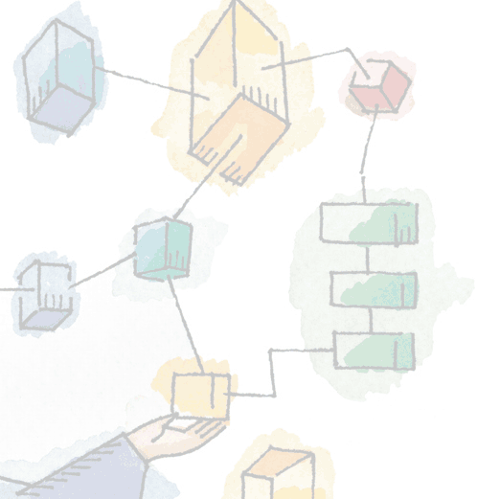
Lecture 1 Introduction

Slide 6
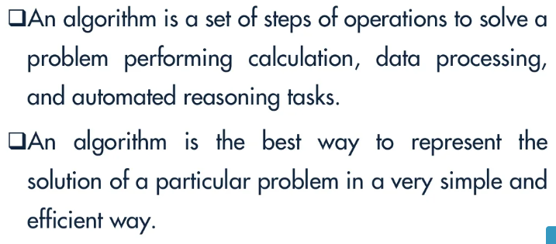
Algorithms

Slide 7
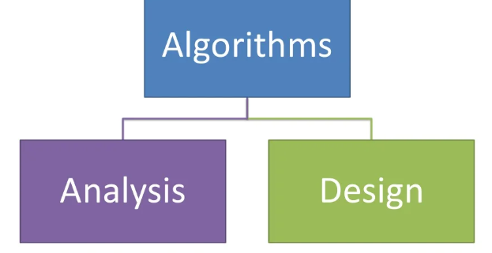
Algorithms

Slide 8
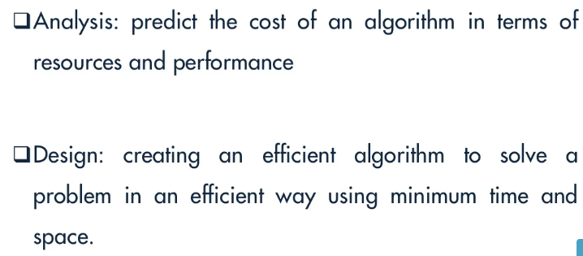
Algorithms

Slide 9
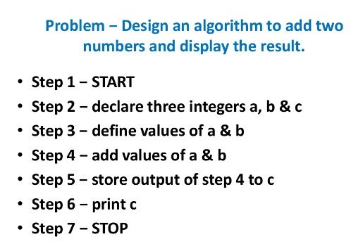
Algorithms

Slide 10
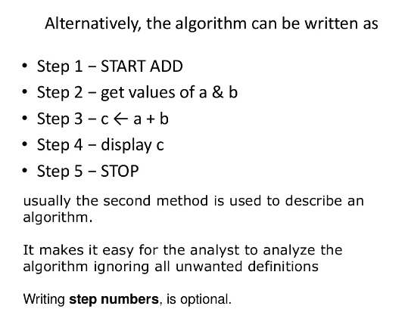
Algorithms

Slide 11
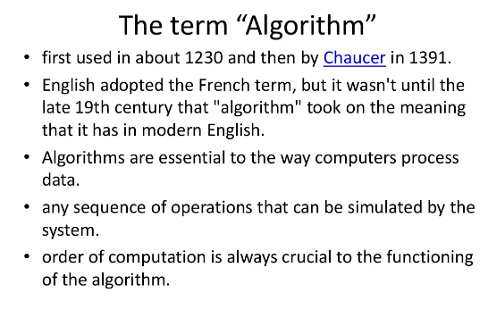
Algorithms

Slide 12
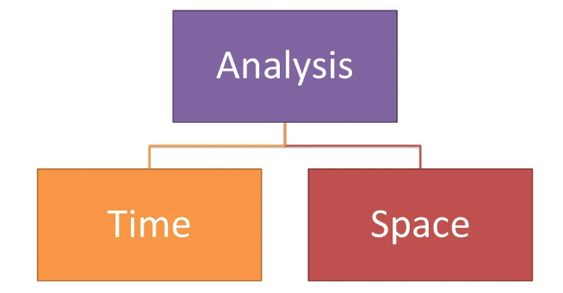
Algorithms

Slide 13
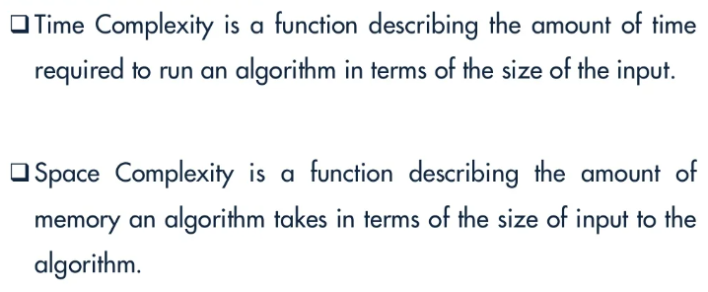
Time Complexity & Space Complexity

Slide 14
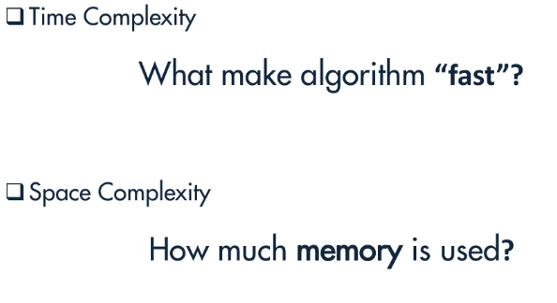
Time Complexity & Space Complexity

Slide 15
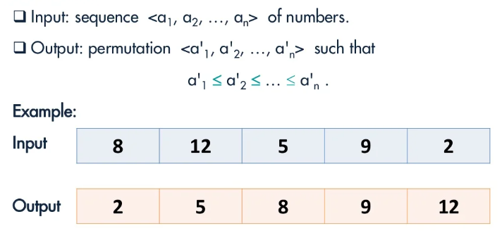
Algorithms

Slide 16
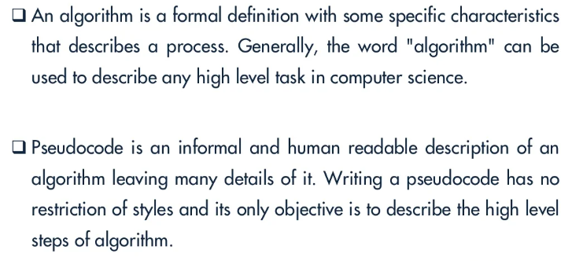
Algorithm vs Pseudocode

Slide 17
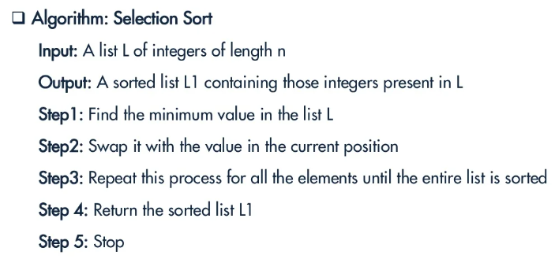
Algorithm

Slide 18
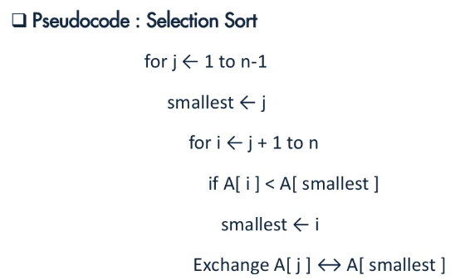
Pseudocode

Slide 19
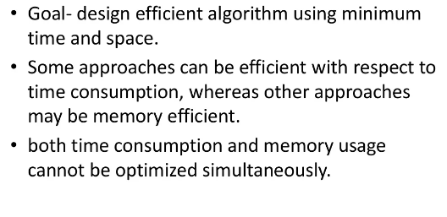
Algorithm Design

Slide 20
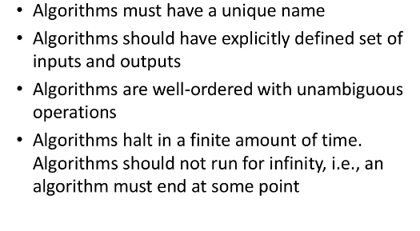
Characteristics of Algorithms

Slide 21
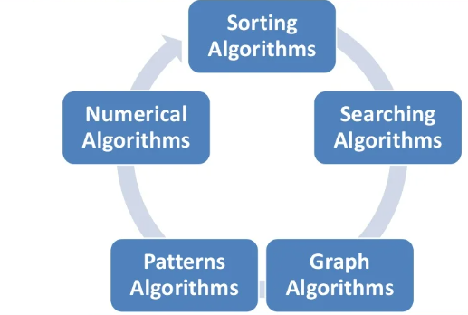
Some Algorithm Types

Slide 22
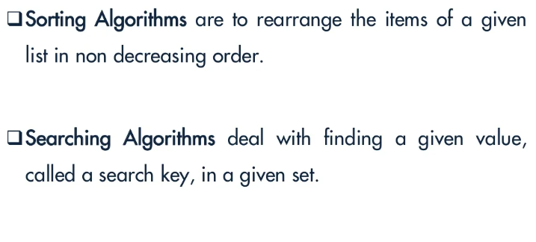
Some Algorithm Types

Slide 23
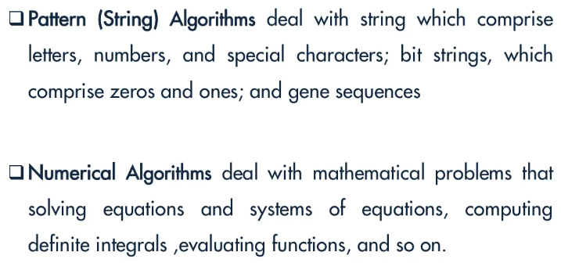
Some Algorithm Types

Slide 24
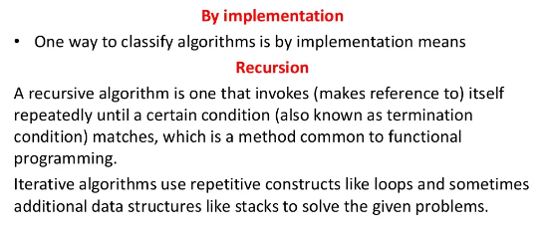
Classification of Algorithms

Slide 25
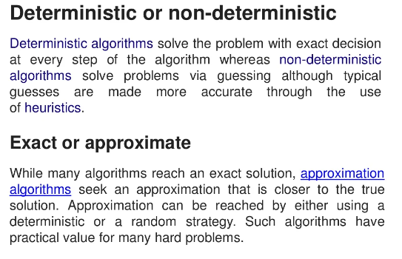
Other Algorithm Types

Slide 26
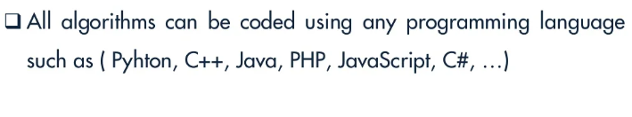
Programming Language

Slide 27
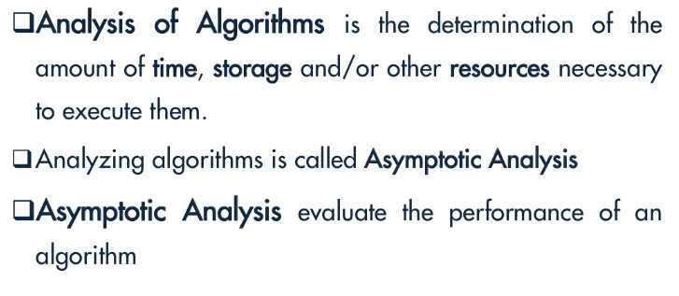
Analysis of Algorithms

Slide 28
Time Complexity

Slide 29
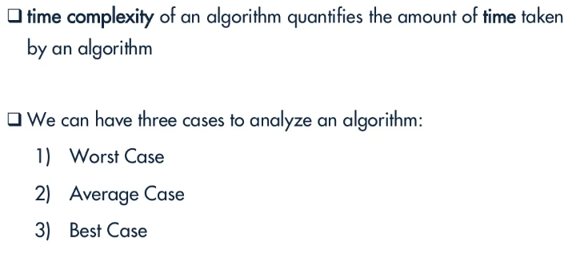
Time Complexity

Slide 30
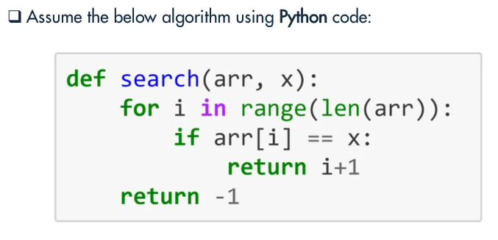
Time Complexity

Slide 31
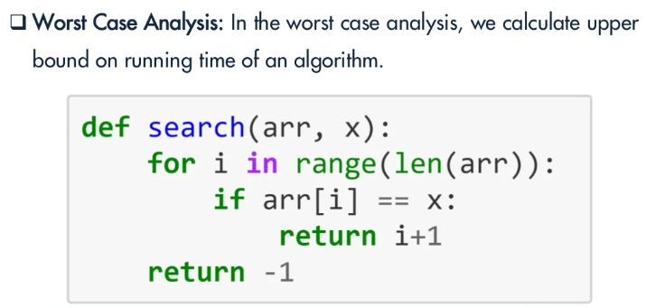
Worst Case Analysis

Slide 32
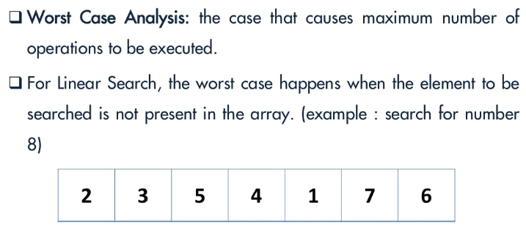
Worst Case Analysis

Slide 33
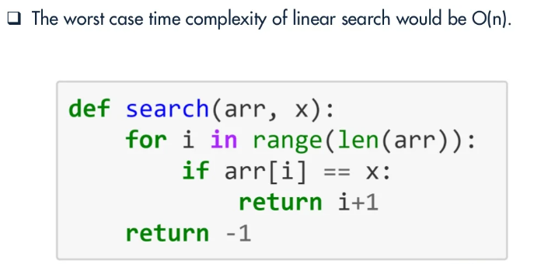
Worst Case Analysis

Slide 34
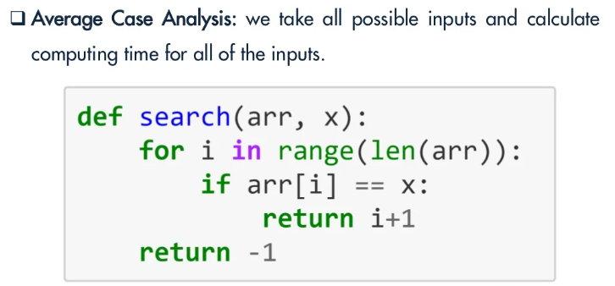
Average Case Analysis

Slide 35
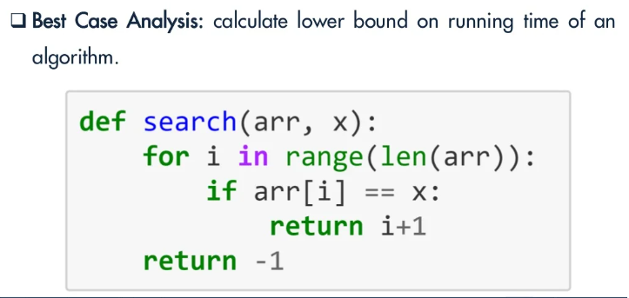
Best Case Analysis

Slide 36
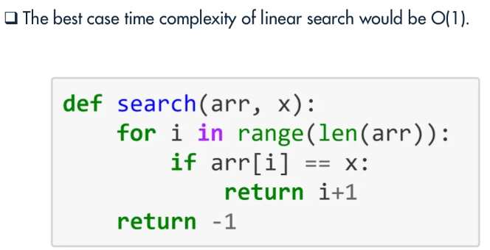
Best Case Analysis

Slide 37
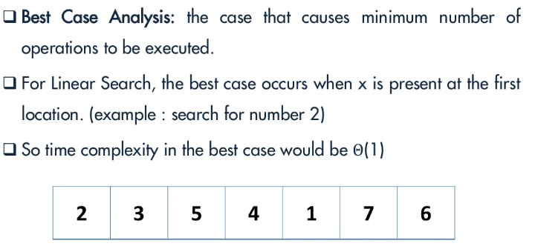
Best Case Analysis

